Slide 1

Linked Lists
June 20th, 2020
by Alex Joslin

Slide 2
What is a Linked List?
A data structure consisting of nodes where each node contains a data field and a reference to the next node.

Slide 3
Python Lists & Java Arrays vs Linked Lists
Java Arrays
Problem:
Once you create an Array, you can’t change the size of the array meaning you can’t add or remove items from it, only change items
Linked Lists
Solution:
Inserting items has O(1) time complexity (only at the beginning and end of a list)
Deleting items has O(1) time complexity
(only at the beginning of a list)
Python Lists
Problem:
Inserting items has O(n) time complexity
Deleting items has O(n) time complexity
Note: Java also has array lists which are
essentially the same thing as lists in Python

Slide 4
Time Complexities
Average Case
Operation | Linked Lists | Python Lists | Java Arrays
Insert front | O(1) | O(n) | N/A
Insert middle | O(n) | O(n) | N/A
Insert End (Append) | O(1) | O(1) | N/A
Delete front | O(1) | O(n) | N/A
Delete middle | O(n) | O(n) | N/A
Delete End | O(n) | O(1) | N/A
Access element | O(n) | O(1) | O(1)
Search | O(n) | O(n) | O(n)
Get Length | O(1) | O(1) | O(1)

Slide 5
How do Linked Lists Look Like?
List / Array
Linked List
None

Slide 6
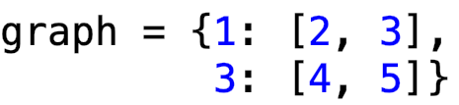
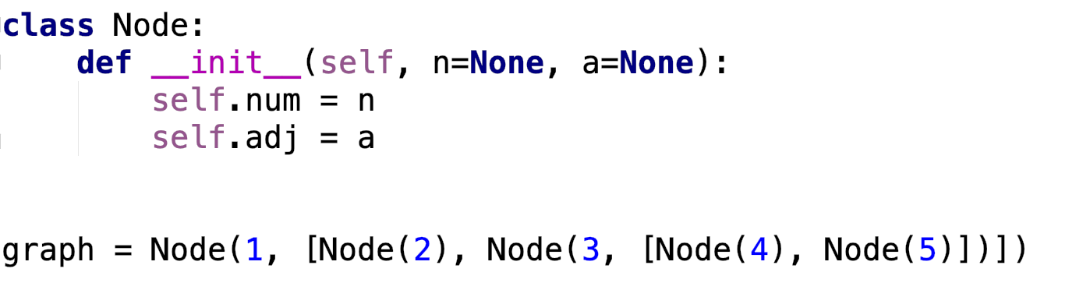
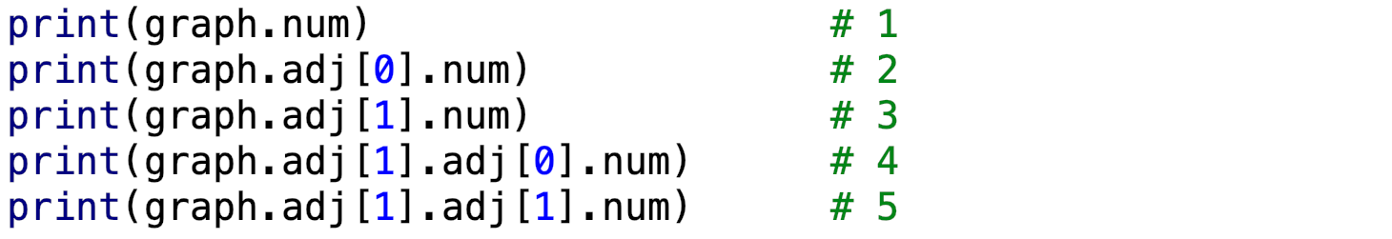
Graph creation with Objects
2
1
4
3
5

Slide 7
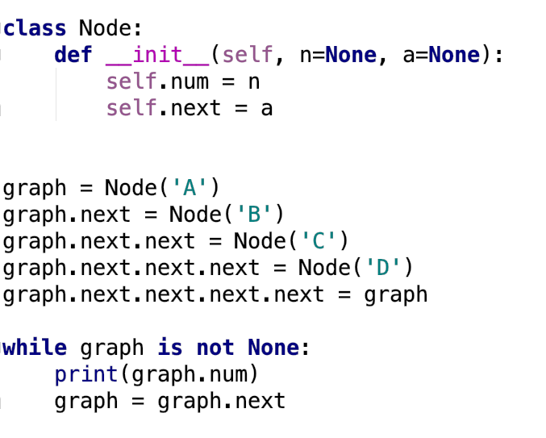
Graph creation with Objects
Output
graph
B
A
C
D
ect ...

Slide 8
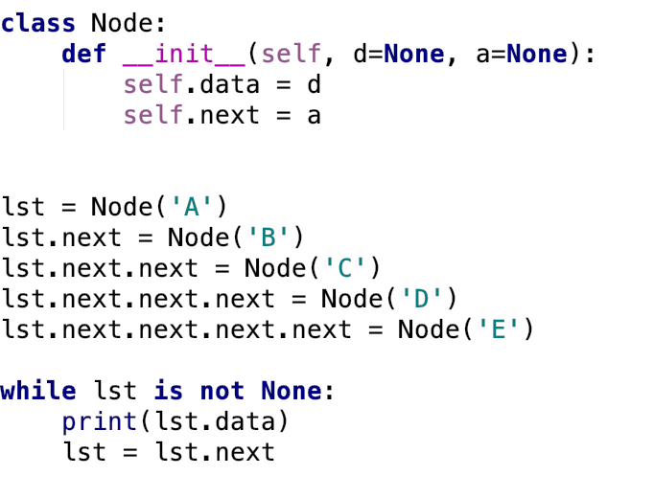

Graph creation with Objects
Output
lst
self.data
self.data
self.data
self.data
self.data
None
self.next
self.next
self.next
self.next
self.next

Slide 9
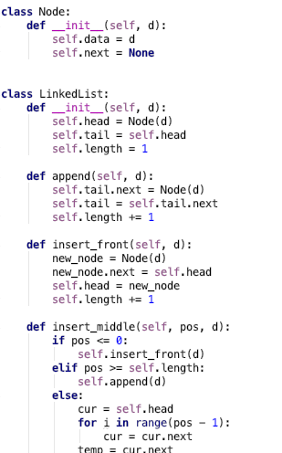
Implementation
self.data = 2
self.next
= next_node
self.data = 9
self.next
= next_node
self.data = 3
self.next
= next_node
self.data = 5
self.next
= next_node
None
self.head
self.tail

Slide 10
Insertion

Slide 11
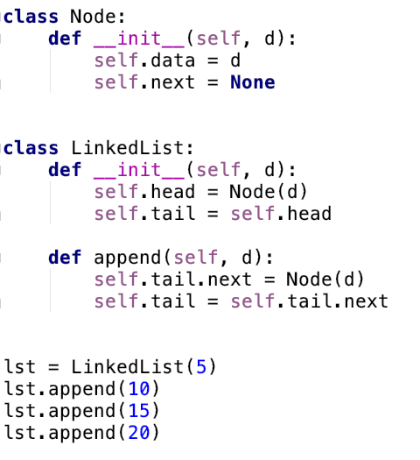
Insert_back (append)
head
tail
5
next
None

Slide 12
Insert_back (append)
head
tail
5
next
None

Slide 13
Insert_back (append)
head
tail
5
next
10
next
None

Slide 14
Insert_back (append)
head
tail
5
next
10
next
None

Slide 15
Insert_back (append)
head
tail
5
next
10
next
None

Slide 16
Insert_back (append)
head
tail
5
next
10
next
15
next
None

Slide 17
Insert_back (append)
head
tail
5
next
10
next
15
next
None

Slide 18
Insert_back (append)
head
tail
5
next
10
next
15
next
None

Slide 19
Insert_back (append)
head
tail
5
next
10
next
15
next
20
next
None

Slide 20
Insert_back (append)
head
tail
5
next
10
next
15
next
20
next
None

Slide 21
Insert_back (append)
head
tail
5
next
10
next
15
next
20
next
None
Time Complexity: O(1)

Slide 22
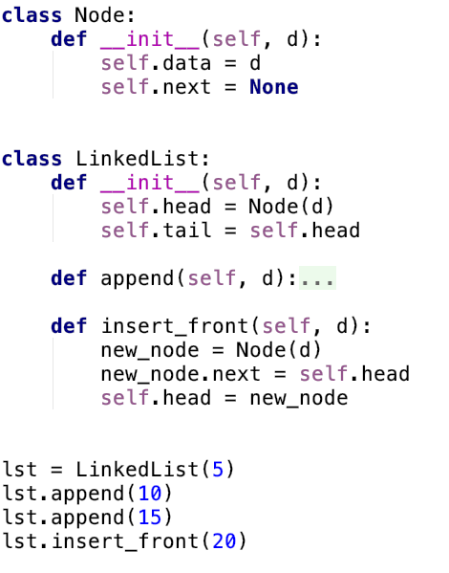
Insert_front
head
tail
5
next
10
next
15
next
None

Slide 23
Insert_front
new_node
head
tail
20
next
None
5
next
10
next
15
next
None

Slide 24
Insert_front
new_node
head
tail
20
next
5
next
10
next
15
next
None

Slide 25
Insert_front
new_node
head
tail
20
next
5
next
10
next
15
next
None

Slide 26
Insert_front
head
tail
20
next
5
next
10
next
15
next
None
Time Complexity: O(1)

Slide 27
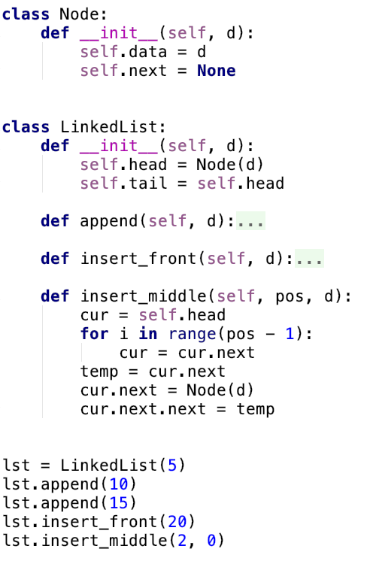
Insert_middle
head
tail
20
next
5
next
10
next
15
next
None

Slide 28
Insert_middle
head
cur
tail
20
next
5
next
10
next
15
next
None

Slide 29
Insert_middle
head
cur
tail
20
next
5
next
10
next
15
next
None

Slide 30
Insert_middle
head
cur
temp
tail
20
next
5
next
10
next
15
next
None

Slide 31
Insert_middle
head
cur
temp
tail
20
next
5
10
next
15
next
None
next
0
next
None

Slide 32
Insert_middle
head
cur
temp
tail
20
next
5
10
next
15
next
None
next
next
0

Slide 33
Insert_middle
head
tail
20
next
5
next
0
next
10
next
15
next
None
Time Complexity: O(n)

Slide 34
Deletion

Slide 35
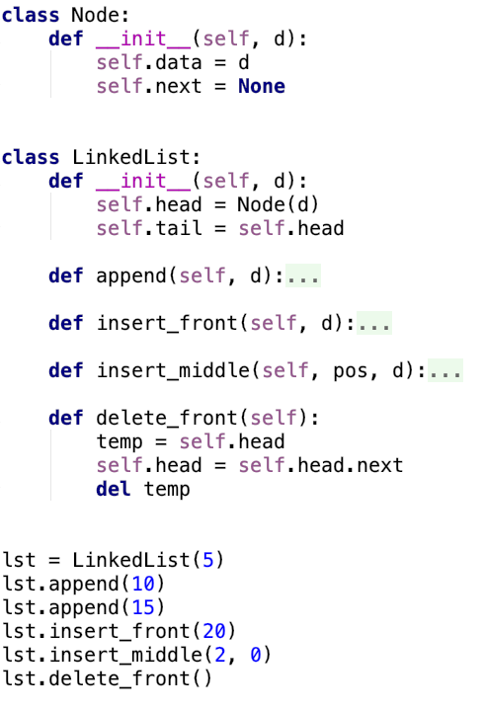
Delete_front
head
tail
20
next
5
next
0
next
10
next
15
next
None

Slide 36
Delete_front
head
temp
tail
20
next
5
next
0
next
10
next
15
next
None

Slide 37
Delete_front
temp
head
tail
20
next
5
next
0
next
10
next
15
next
None

Slide 38
Delete_front
head
tail
20
next
5
next
0
next
10
next
15
next
None

Slide 39
Delete_front
head
tail
5
next
0
next
10
next
15
next
None

Slide 40



Memory Deallocation
(No Garbage Collection)
Stack
Heap
C++
main()
delete_front()
temp
20
next
Reference
Count:
1
Stack
Heap
0
Python
main()
delete_front()
temp
20
next
(With Garbage Collection)

Slide 41
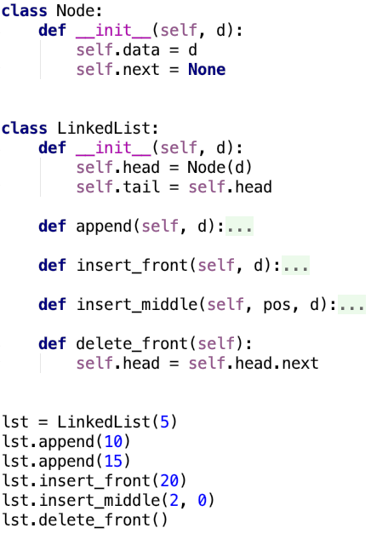
Delete_front
head
tail
20
next
5
next
0
next
10
next
15
next
None

Slide 42
Delete_front
head
tail
20
next
5
next
0
next
10
next
15
next
None

Slide 43
Delete_front
head
tail
5
next
0
next
10
next
15
next
None
Time Complexity: O(1)

Slide 44
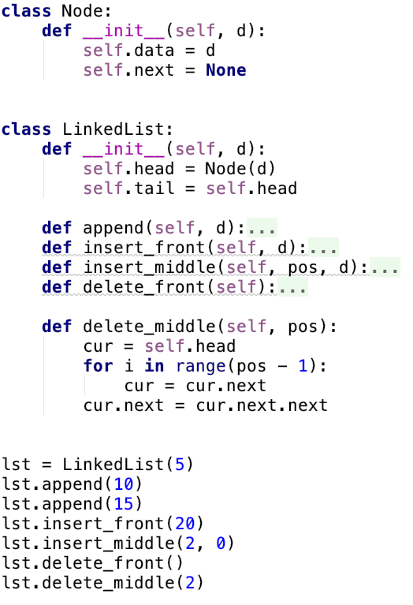
Delete_middle
head
tail
5
next
0
next
10
next
15
next
None

Slide 45
Delete_middle
head
cur
tail
5
next
0
next
10
next
15
next
None

Slide 46
Delete_middle
head
cur
tail
5
next
0
next
10
next
15
next
None

Slide 47
Delete_middle
head
cur
tail
5
next
0
10
next
15
next
None
next

Slide 48
Delete_middle
head
tail
5
next
0
15
next
None
next

Slide 49
Delete_middle
head
tail
5
next
0
next
15
next
None
Time Complexity: O(n)

Slide 50
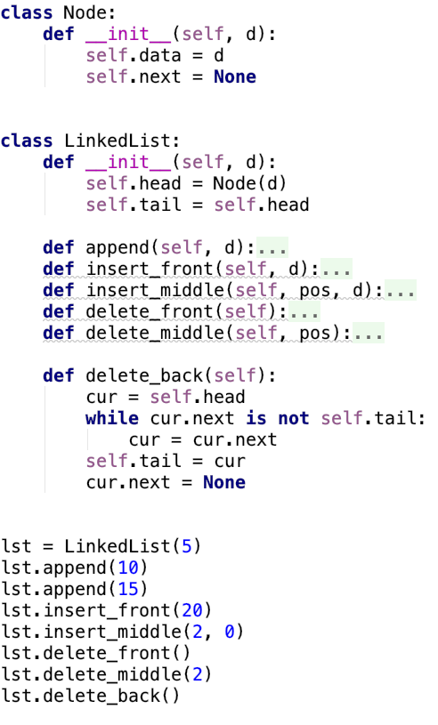
Delete_back
head
tail
5
next
0
next
15
next
None

Slide 51
Delete_back
head
cur
tail
5
next
0
next
15
next
None

Slide 52
Delete_back
head
cur
tail
5
next
0
next
15
next
None

Slide 53
Delete_back
head
cur
tail
5
next
0
next
15
next
None

Slide 54
Delete_back
head
cur
tail
5
next
0
next
None

Slide 55
Delete_back
head
tail
5
next
0
next
None
Time Complexity: O(n)

Slide 56
Other Useful Methods
display()
search()
reverse()
copy()
merge()

Slide 57
Types of Linked Lists
Linear Linked List
None
Doubly Linked List
None
None
Circular Linear Linked List
Circular Doubly Linked List

Slide 58
Notes
Note: There is a lot of confusion online on the time complexity of a linked list.
In some sites you will see that the time complexity of appending to a linked list is
O(n) but that depends on the implementation. If it is implemented without a tail
pointer it is O(n) where with a tail pointer it is (1)

Slide 59
The End

